Slide 1
Online Shopping Mall
Project presentation
Team members :
Surjyendu Ray
Suvendu Bhattacharyya
Sandip Shaw
Souvik Sett

Slide 2

Online Shopping Mall
Introduction
Purpose : -
The Online Shopping Mall (OSM) web application is intended to provide complete solutions for vendors as well as customers through a single get way using the internet as the sole medium. It will enable vendors to setup online shops, customer to browse through the shop and purchase them online without having to visit the shop physically. The administration module will enable a system administrator to approve and reject requests for new shops and maintain various lists of shop category .
Simplicity of design, execution and operation is main goal of this unique mall. Additionally, the efficiency of this online business over other existing, similar ventures and traditional brick-and-mortar shops is a hallmark of our OSM.
Online Shopping Mall – Team SkyNet

Slide 3

The scope of our project:
Online Shopping Mall
Scope :
Secure registration and profile management facilities for Customers
Browsing through the e-Mall to see the items that are there in each category of products like Apparel, Kitchen accessories, Bath accessories, Food items etc.
Adequate searching mechanisms for easy and quick access to particular products and services.
Creating a Shopping cart so that customers can shop ‘n’ no. of items and checkout finally with the entire shopping carts.
Regular updates to registered customers of the OSM about new arrivals.
Uploading ‘Most Purchased’ Items in each category of products in the Shop like Apparel, Kitchen accessories, Bath accessories, Food items etc.
Strategic data and graphs for Administrators and Shop owners about the items that are popular in each category and age group.
Maintaining database of regular customers of different needs.
Online Shopping Mall – Team SkyNet

Slide 4

The scope of our project(contd.):
Online Shopping Mall
Scope :
Shop employees are responsible for internal affairs like processing orders, assure home delivery, getting customer's delivery-time feedback, updating order's status and answering client's queries online.
Feedback mechanism, so that customers can give feedback for the product or service which they have purchased. Also facility rating of individual products by relevant customers. Also feedback can be given on the performance of particular vendors and the entire mall as well.
Adequate payment mechanism and gateway for all popular credit cards, cheques and other relevant payment options, as available from time to time.
For the previous paragraph, depicting the functions of the system, from the perspective of the various users of the system, the following colour codes has been used :
RED for administrator
BLUE for customer of the shopping mall
GREEN for the employees.
Online Shopping Mall – Team SkyNet

Slide 5


The nuts and bolts to be used :
Technologies & Environments
Programming languages
JAVA EE: Java Enterprise Edition is a programming platform— part of the Java Platform-for developing and running distributed multi-tier architecture Java applications, based largely on modular software components running on an application server.
HTML, XML: Hyper Text Markup Language and Extensible markup Language are the predominant markup languages for web pages. It provides a means to describe the structure of text-based information in a document and to supplement that text with interactive forms, embedded images, and other objects.
JavaScript: A client side scripting language used to create dynamic web content and user interface.
Tools and developement environment
Apache Tomcat 6.0.18 Server: Apache Tomcat is a Servlet container developed by the Apache Software Foundation (ASF). Tomcat implements the Java Servlet and the JavaServer Pages (JSP) specifications from Sun Microsystems, and provides a "pure Java" HTTP web server environment for Java code to run.
ECLIPSE J2EE: Eclipse is a toolkit which is designed for the creation of complex projects, providing fully dynamic web application utilizing EJB’s. This consist of EJB tools , CMP ,data mapping tools & a universal test client that is designed to aid testing of EJB’s.
Online Shopping Mall – Team SkyNet

Slide 6


OSM perspective :
Product Perspective
OSM is aimed towards the vendors who want to reach out to the maximum cross-section of customer and common people who can be potential customer. This project envisages bridging the gap between the seller, the retailer and the customer. OSM should be user-friendly, ‘quick to learn’ and reliable software for the above purpose. OSM is intended to be a stand-alone product and should not depend on the availability of other software. It should run on all platforms whichever has a JAVA implementation.
Administrator
Managers
Visitor
Employees
Customer
Shop Owner
Online Shopping Mall – Team SkyNet

Slide 7
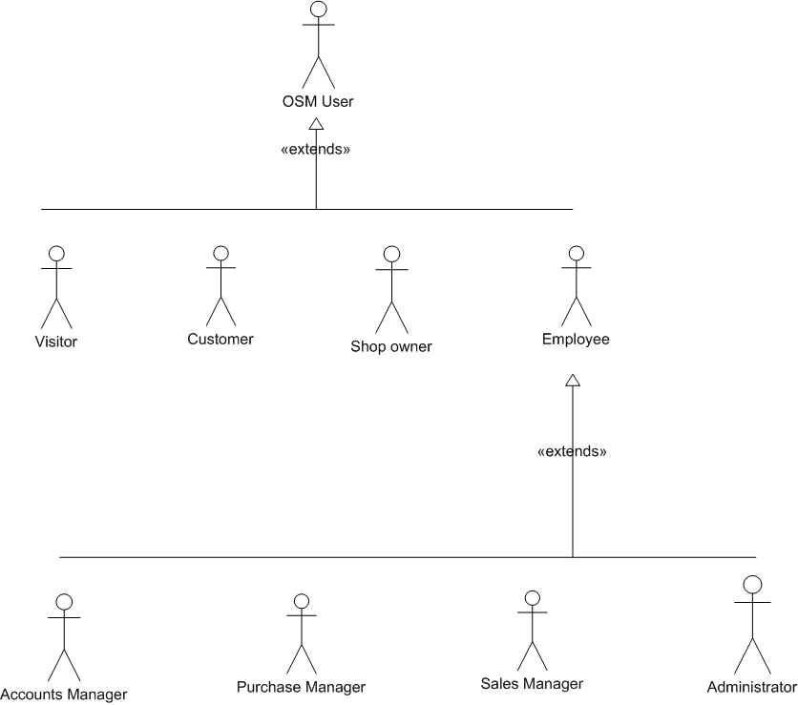

Use case model survey :
Basic user hierarchy :
Online Shopping Mall – Team SkyNet

Slide 8
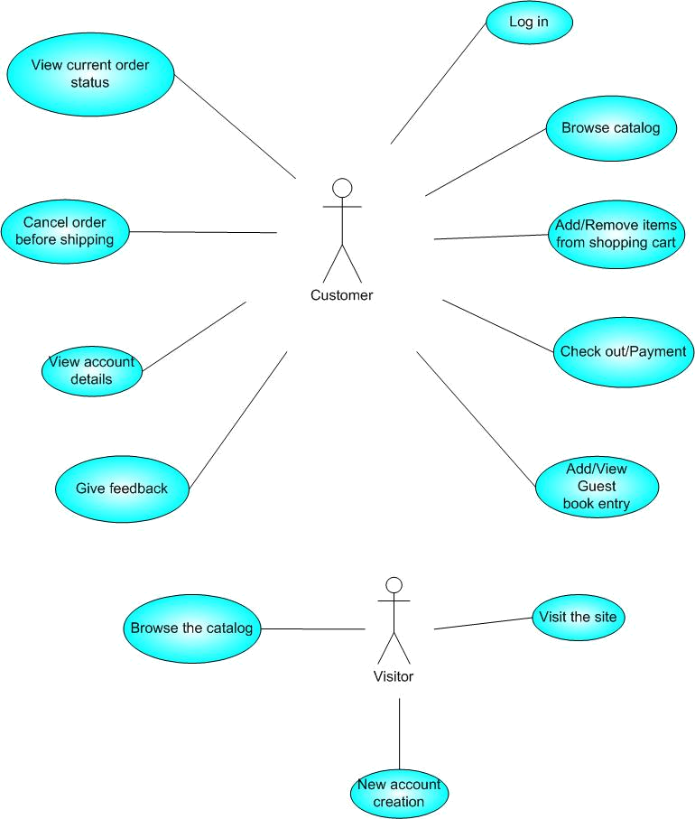
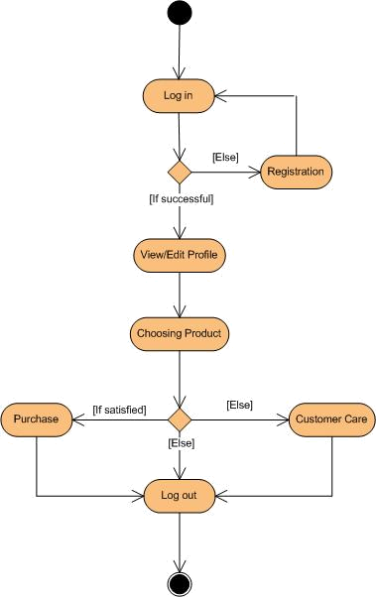

Use cases with activity diagrams :
Online Shopping Mall – Team SkyNet

Slide 9
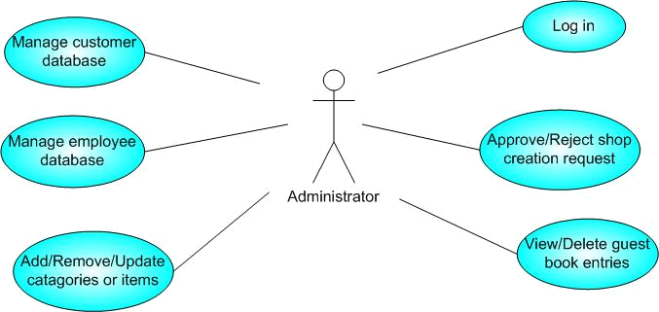
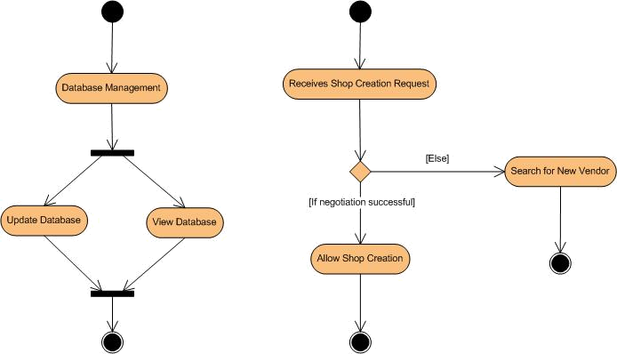
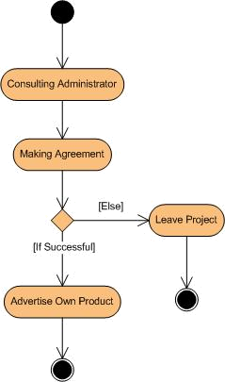
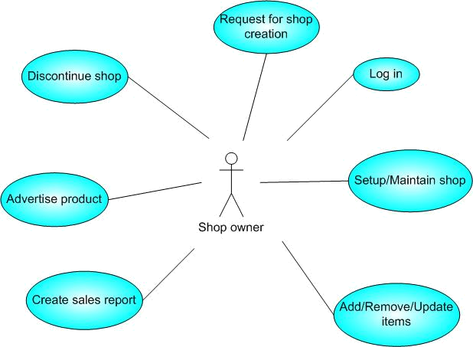

Use cases with activity diagrams :
Online Shopping Mall – Team SkyNet

Slide 10
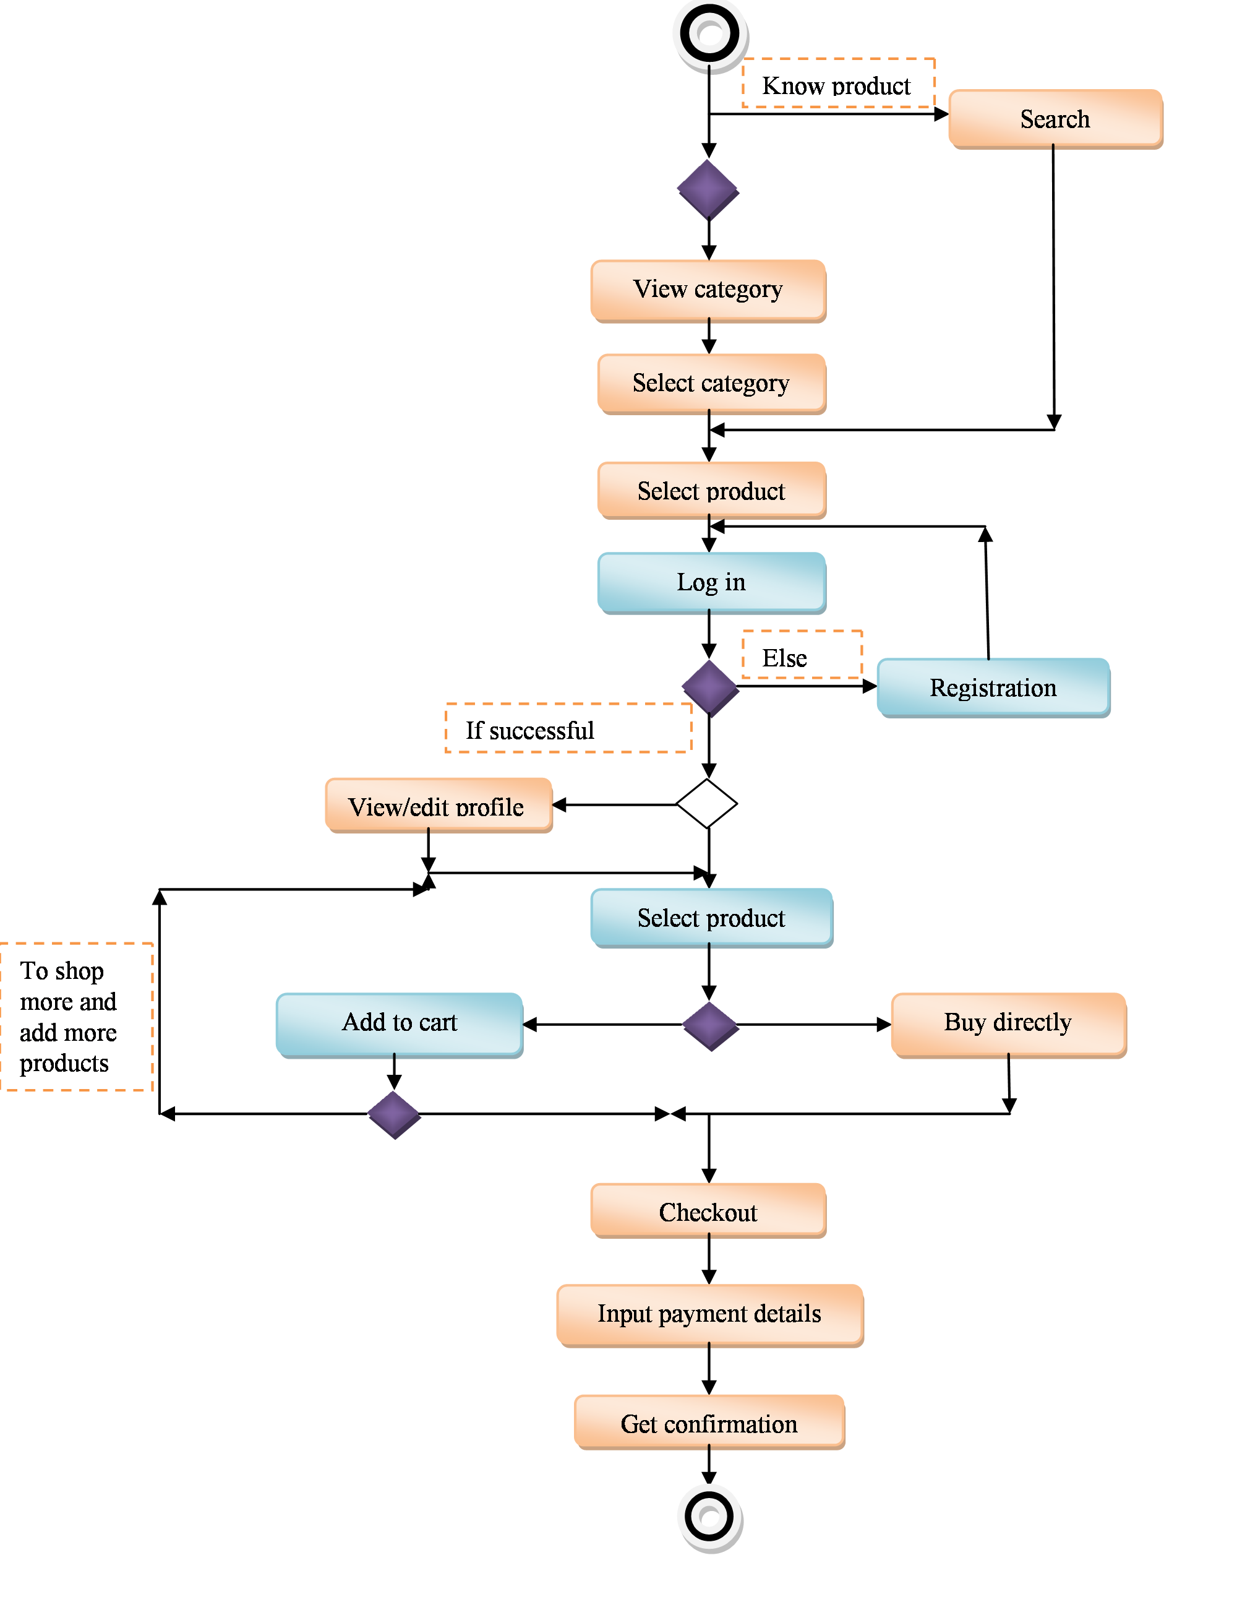
Action Sequences :
Online Shopping Mall – Team SkyNet

Slide 11








Customer Requirements :
Performance ,even in old hardware.
Stability.
User Friendliness.
Secured computing.
Service and troubleshooting.
Quality
Stability
Service
User Friendliness
Security
Online Shopping Mall – Team SkyNet

Slide 12

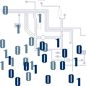

Meeting the Needs :
App.
Stability of JAVA & platform independence.
Ability to run on outdated hardware.
Performs in sticky situations without crashing.
Ease of system administration using user-friendly forms.
JVM
CART
PLATFORM
CUSTOMER
OSM
CUSTOMER DATABASE
GUI
EXTENSIBLE
Easy UPDATE
SuperSERVICE
Online Shopping Mall – Team SkyNet

Slide 13

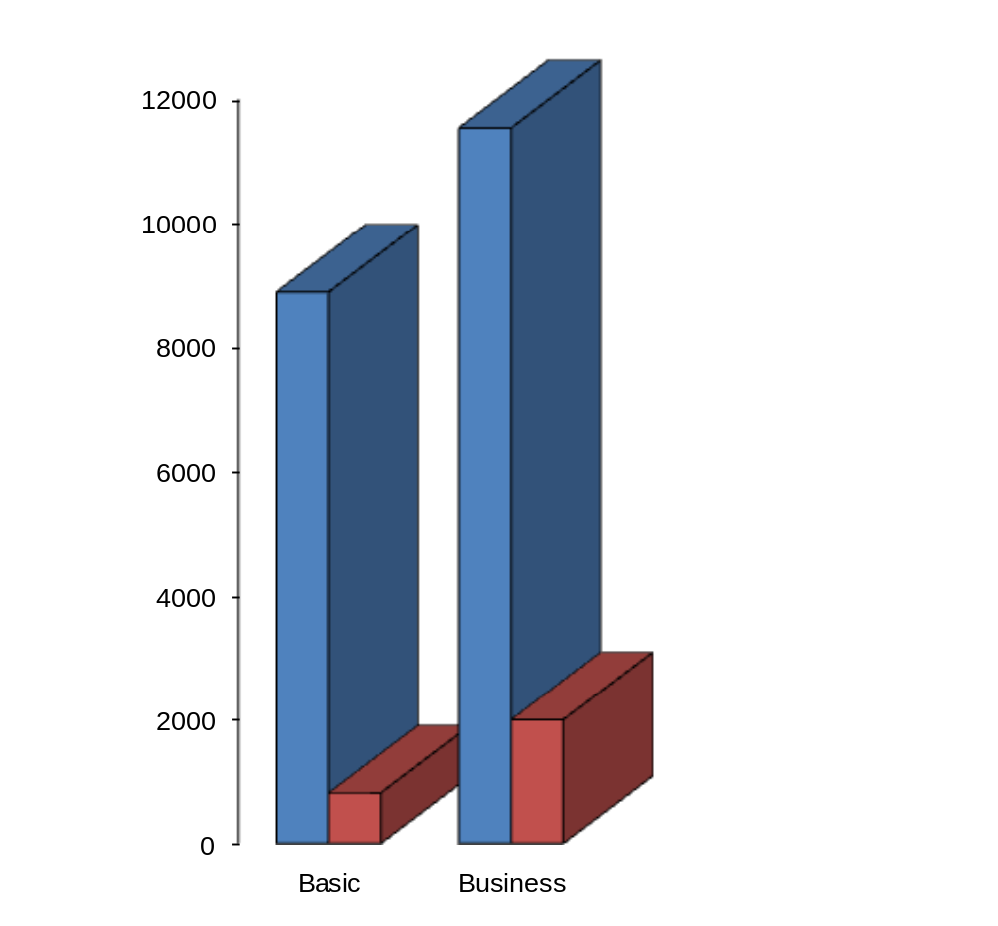

Cost Analysis :
OSM is far cheaper than our nearest competitor, Expos2
The basic edition provides free phone support 24x7.
The business edition has guaranteed on-spot support.
Online Shopping Mall – Team SkyNet

Slide 14


“The best thing about the future is that it comes only one day at a time.,,
Abraham Lincoln (1809-1865)
Online Shopping Mall – Team SkyNet

Slide 15


Next steps and the future :
Evolution of OSM :
The current implementation does not take warehousing in its stride. In the upcoming versions warehousing will be done from within the ambits of the mall to lessen the burden for the vendors.
Implementation of payment gateways through a single window to facilitate easy payment.
Dynamic price model by which prices can be changed based on demand and supply as well as possibility of special offers e.g.. Thanksgiving, from within the very ambits of the mall.
Dynamic Storefront: Each customer will have a web page personalized based on his or her recent purchases. This is the equivalent of having a unique storefront for each customer in hopes of drawing in as many return customers as possible.
Online Shopping Mall – Team SkyNet

Slide 16

That Was It ! The Beginning of OSM 1.0
And World Domination !
Online Shopping Mall – Team SkyNet

